Slide 1
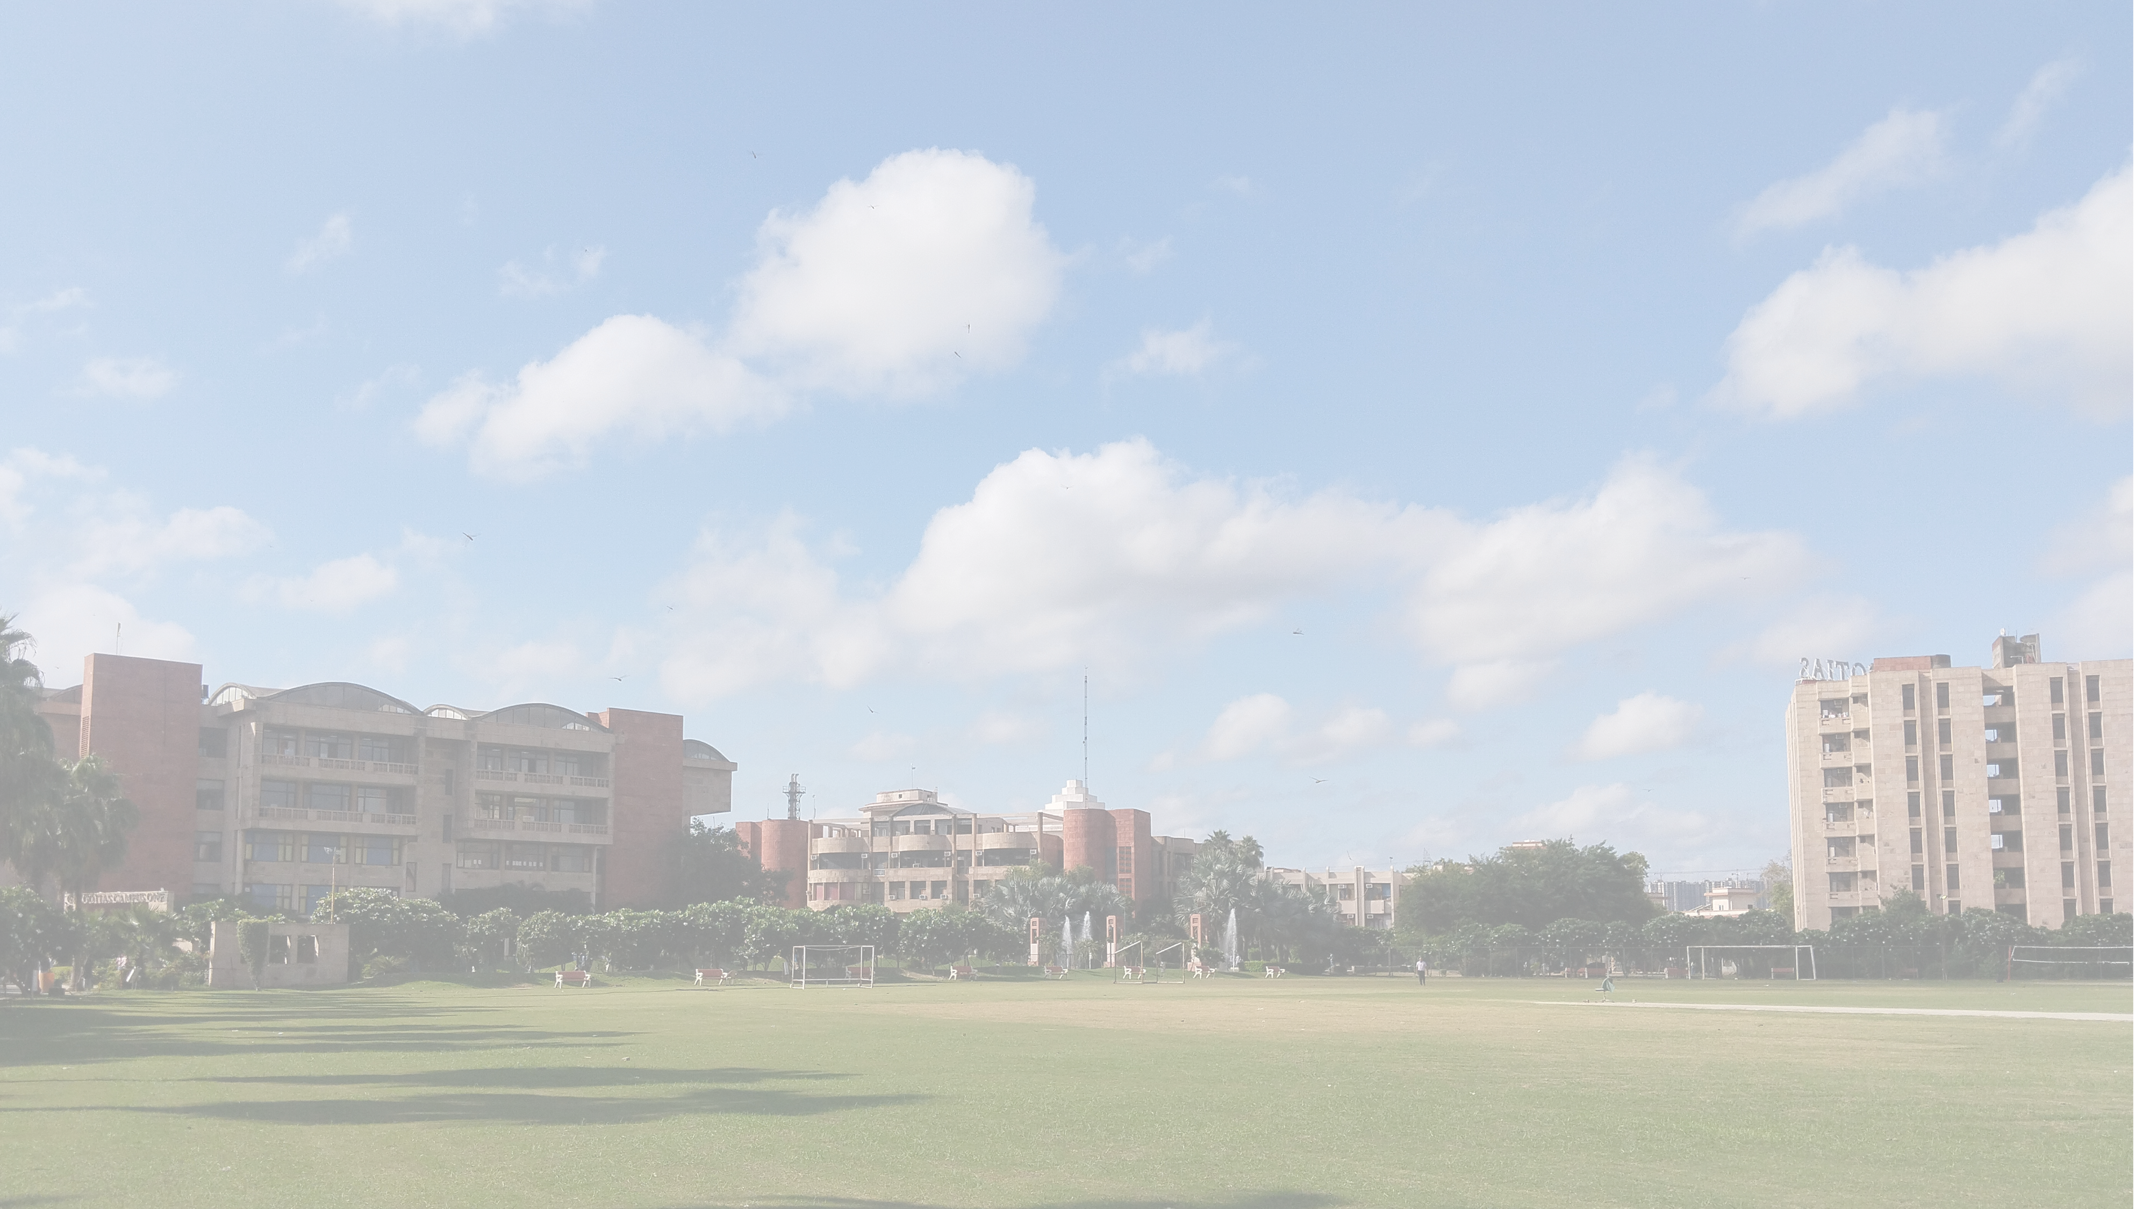

TEAM _HACKTRIO
presents
BHARAT Odyssey
“Unleash Your Inner Explorer!"
“Explore the world, One Adventure at a Time”

Slide 2

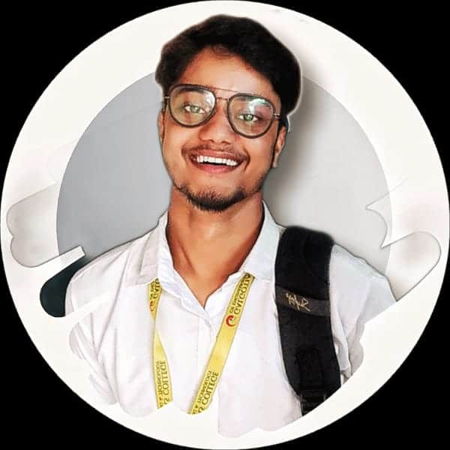
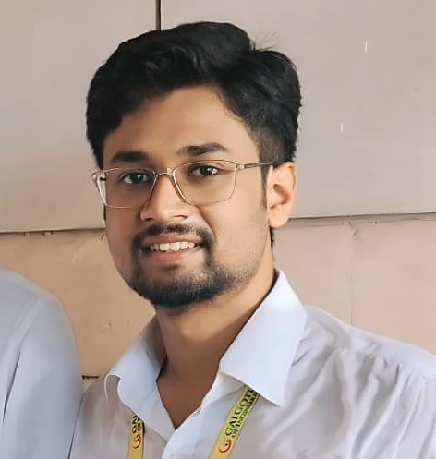
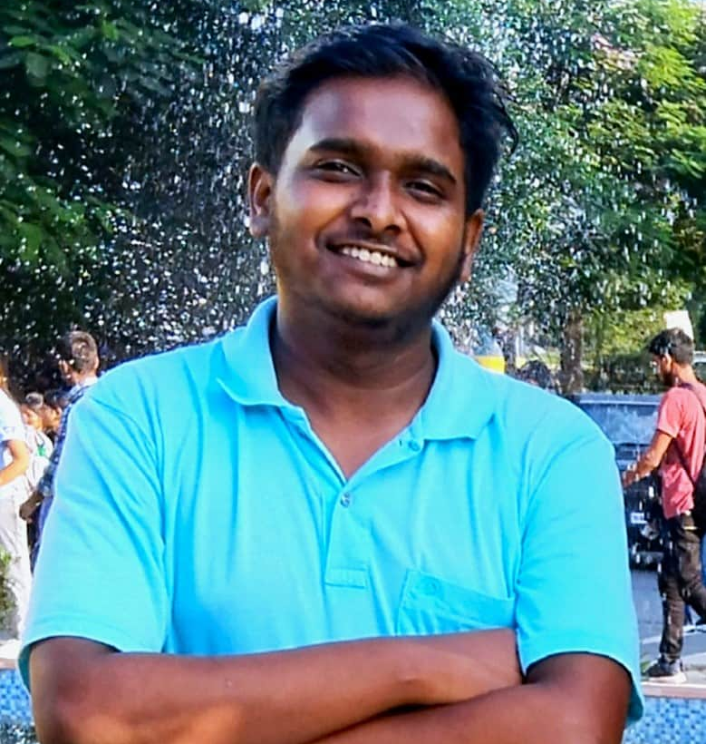
OUR TEAM
Amrit Raj
Aman Raj
.
Aditya Kumar
28.09.24

Slide 3

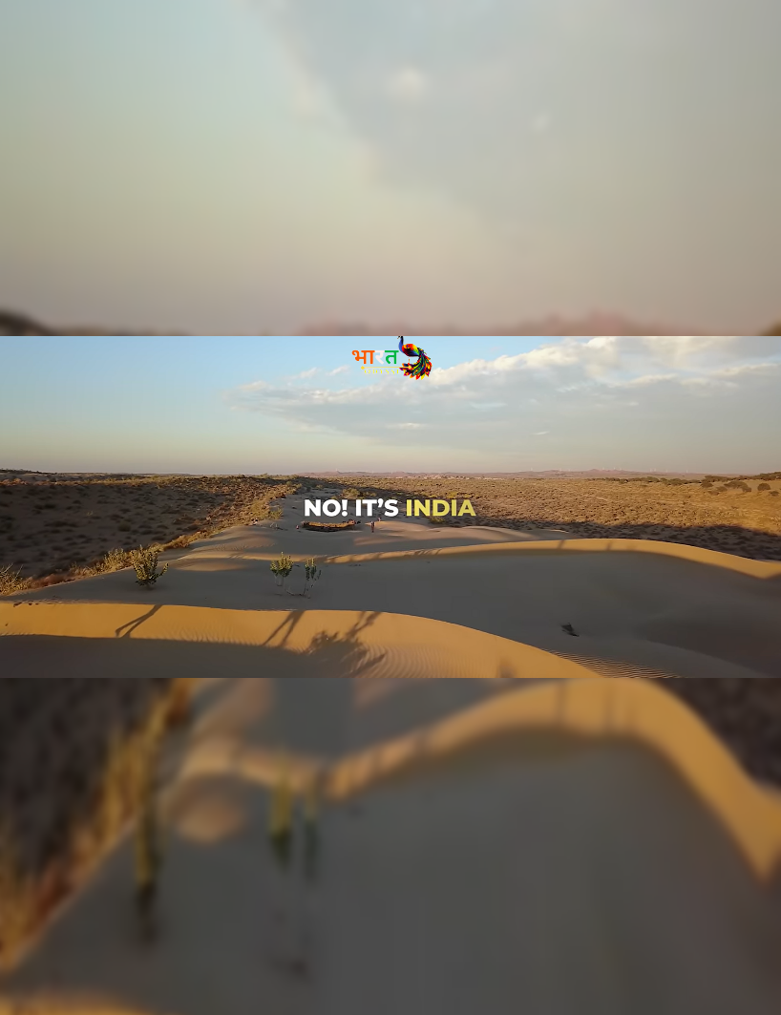
INTRODUCTION
We believe that travel is not just a journey, but a transformative experience. Whether you’re seeking pristine beaches, bustling cityscapes, or serene mountain retreats, we’ve curated a selection of unforgettable destinations just for you.
Explore unique cultures, savor delectable cuisines, and uncover hidden gems off the beaten path. Our expert guides and personalized itineraries ensure that every moment of your trip is filled with wonder and discovery.
Join us as we embark on a journey of a lifetime—because the world is waiting for you! Start your adventure today!
.
28.09.24

Slide 4




MAIN OBJECTIVES
01
02
03
Seamless Booking Process
Easy E-Ticketing
Personalized Recommendations
28.09.24
A straightforward booking system accommodations, and activities that minimizes steps and maximizes clarity
Enables you to make out one step e-ticketing. You can book and manage your ticket online, anytime & anywhere
Personalized travel suggestions based on user preference, search history, and popular trends..

Slide 5
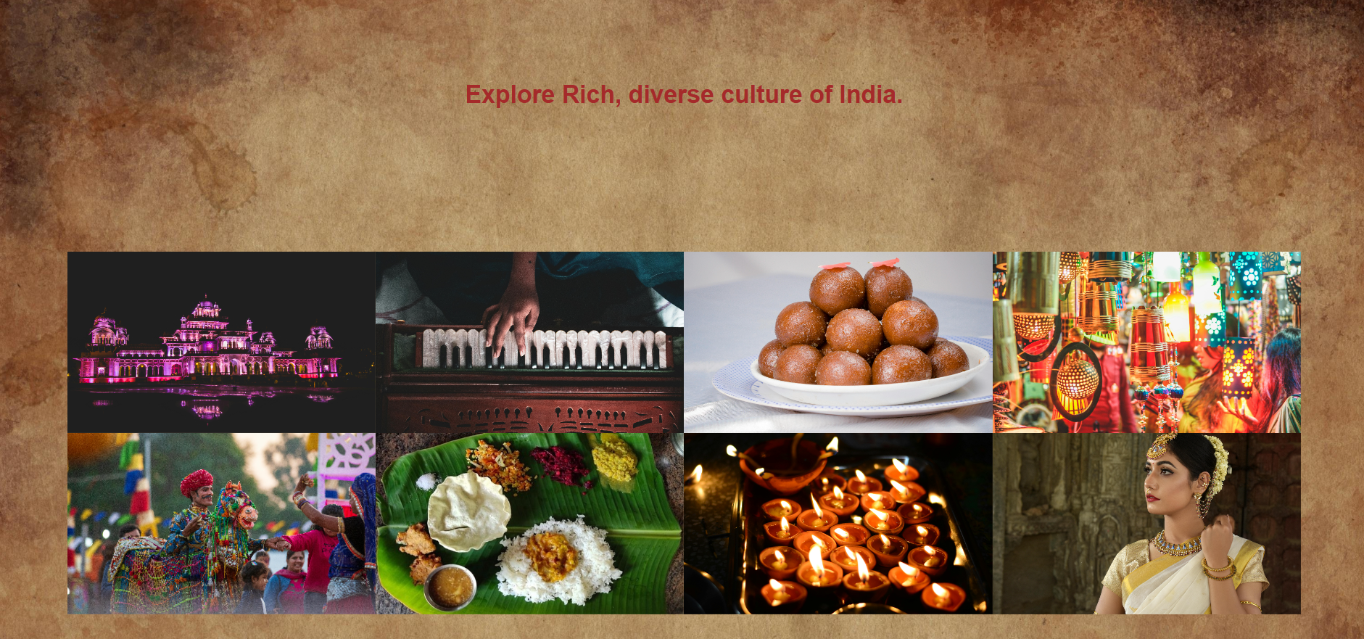
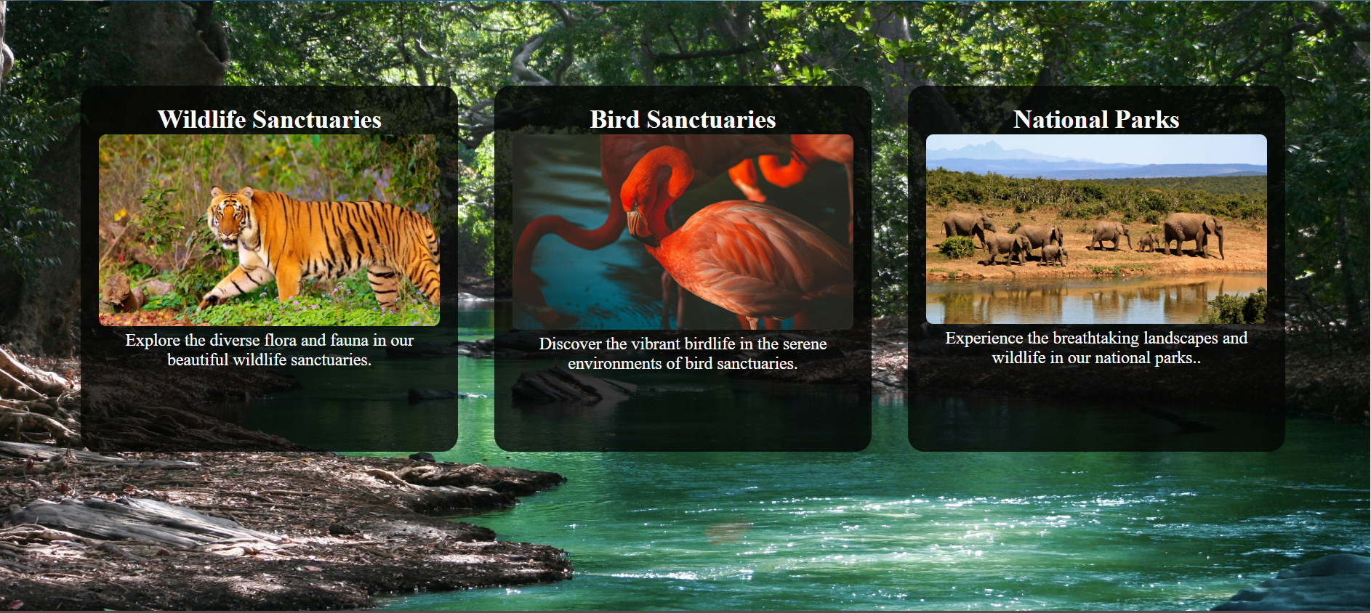
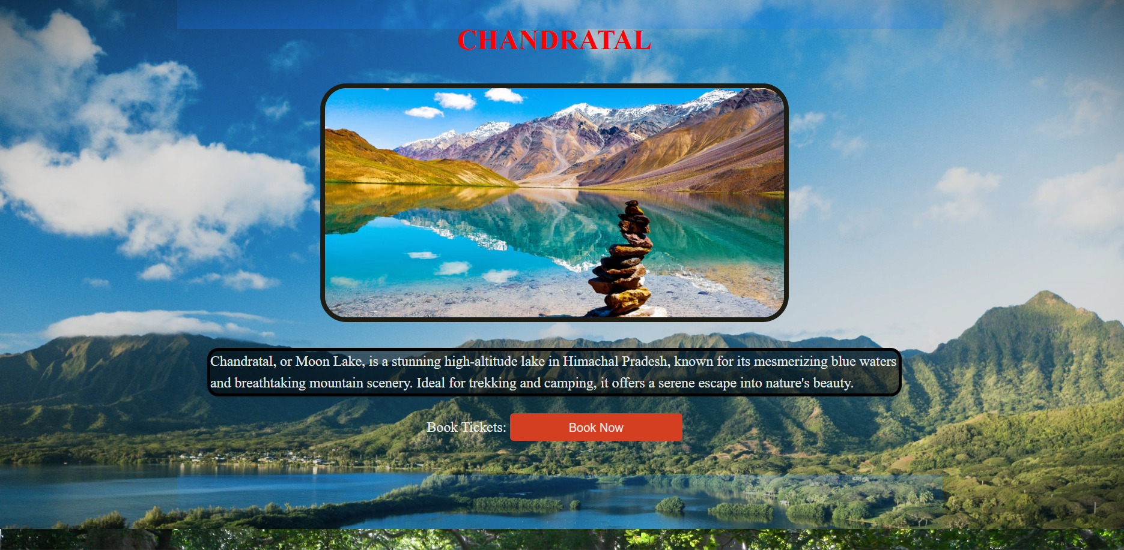
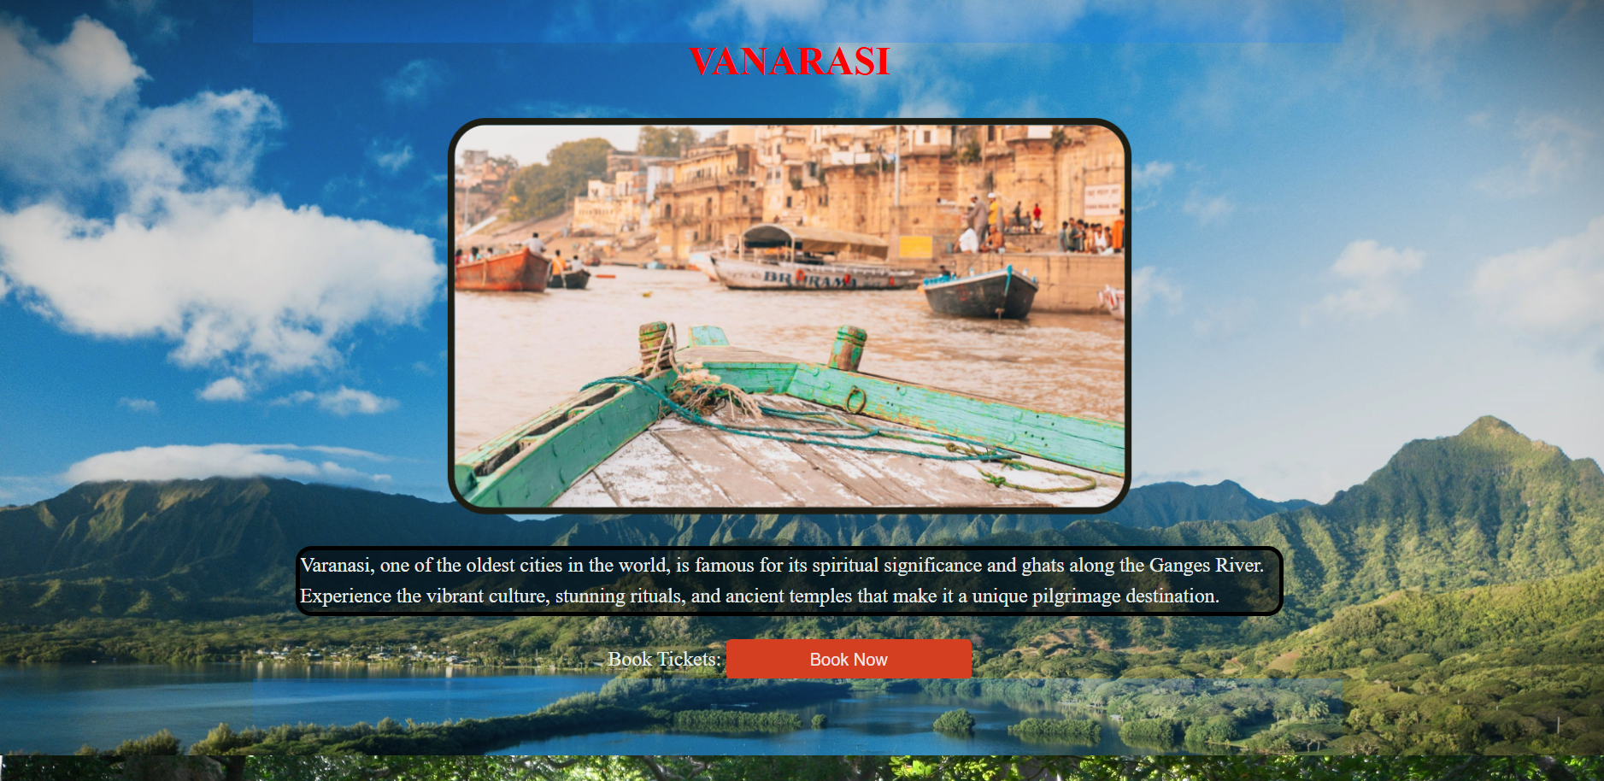
Web Pages
28.09.24

Slide 6

KEY FEATURES
01
02
Travel & Tourism Management
Fast Processing
It simplifies the management process in travelling.
Fast processing and immediate results with high security.
03
04
Less Effort
Navigation
28.09.24
Minimizing human effort and cost effective.
Navigation through the site is easy

Slide 7
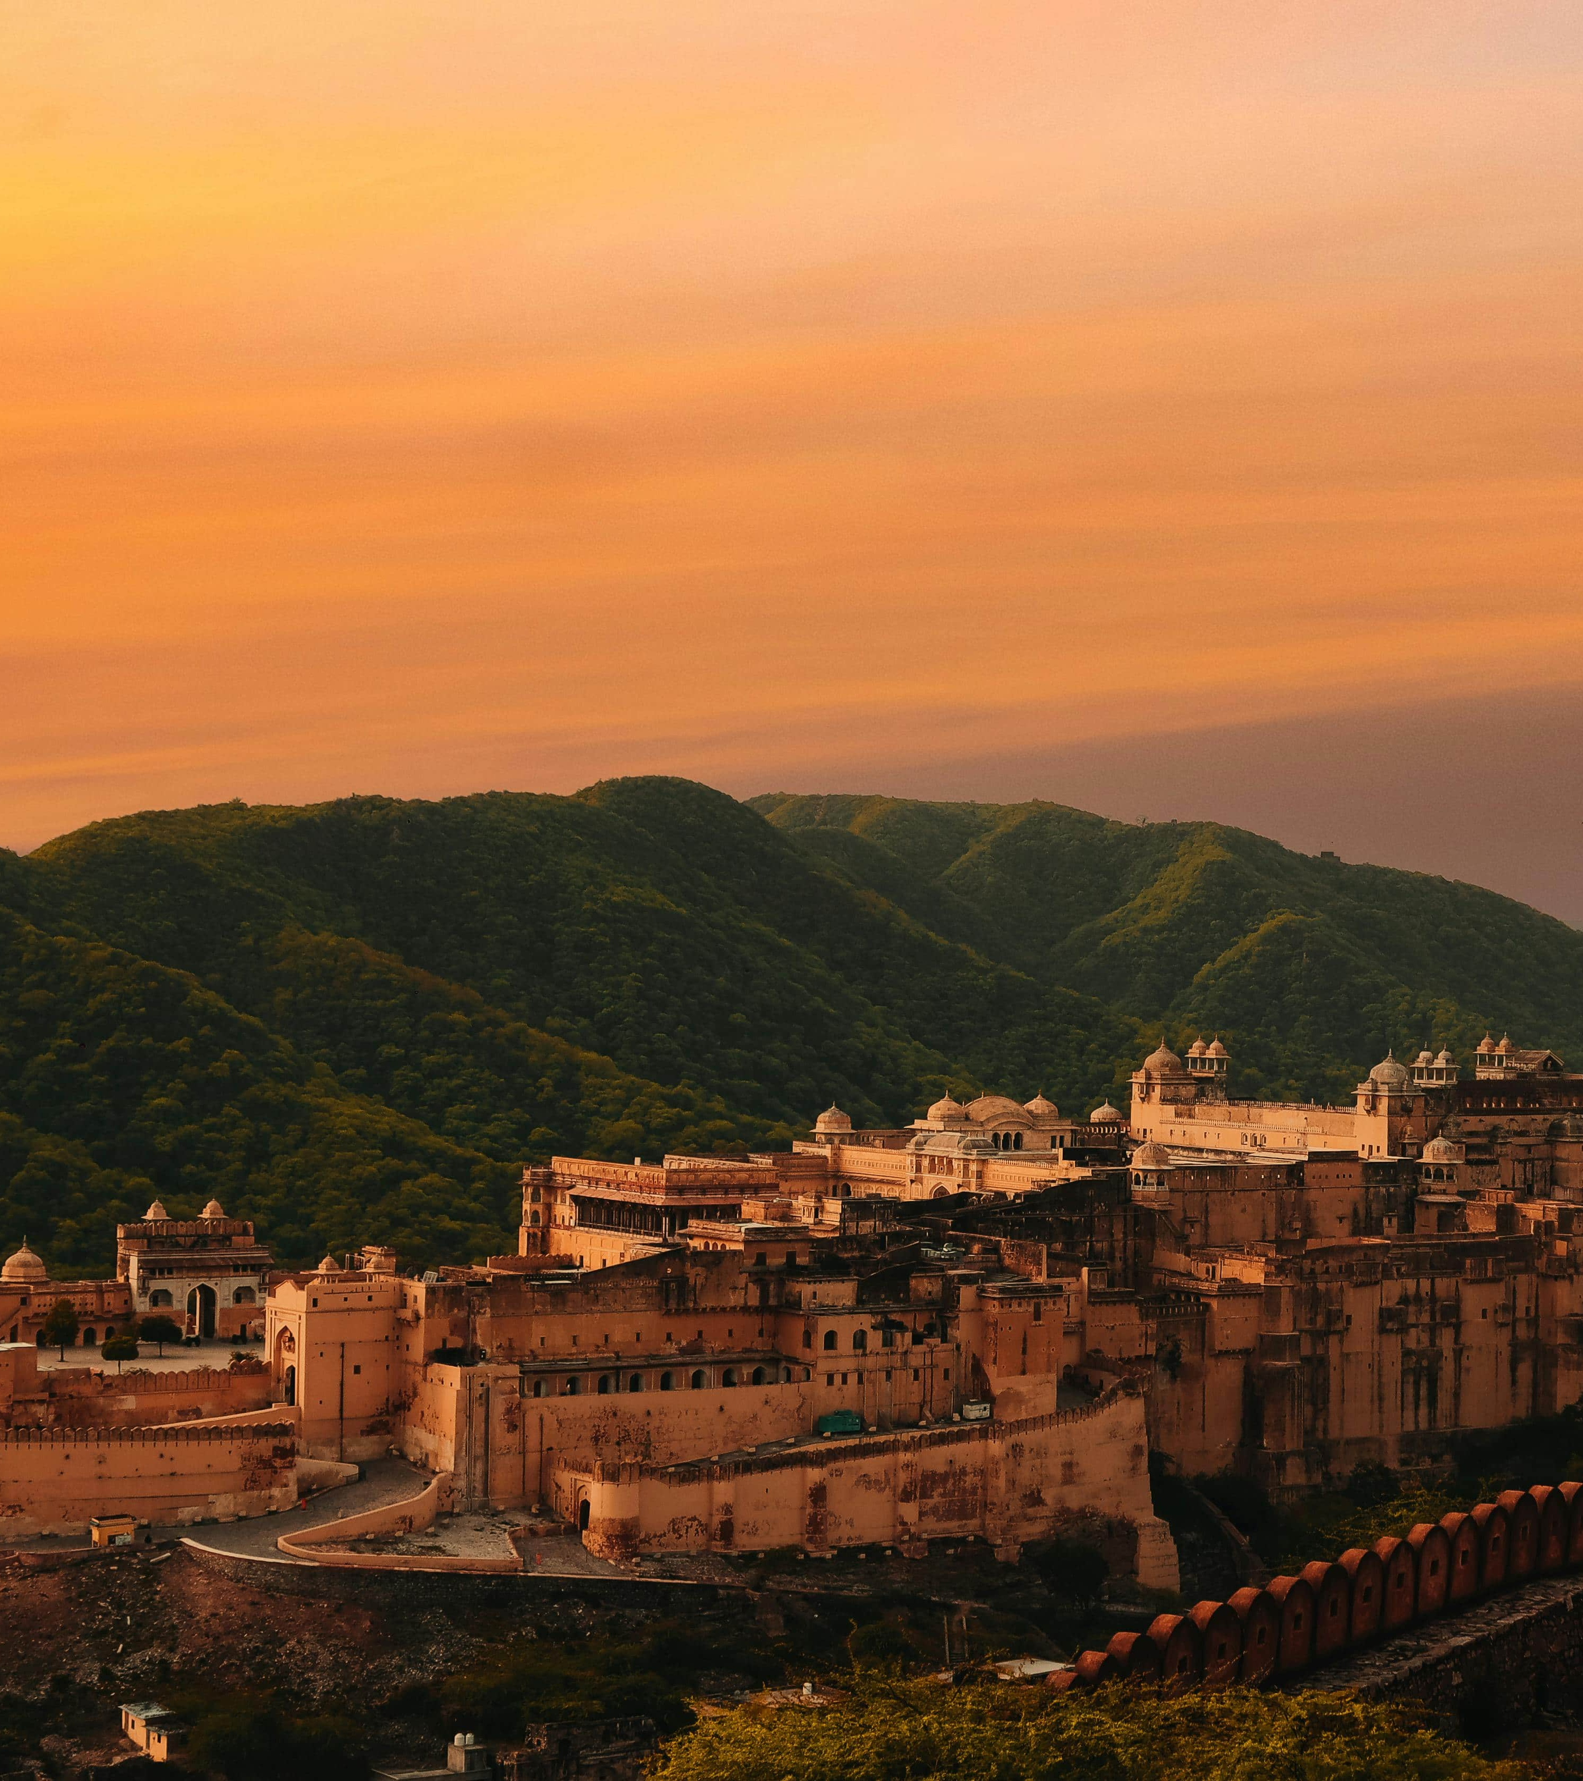

This project is integration of HTML, CSS and Java Script.
We have include an API which redirected towards real time access and also same for weather, CSS part help us to enhance the frontend, by enabling us to add cascading sheets that supports html files to enlighten it.
The basic theme and addition of pics and use of redirecting tags is being achieved by using HTML version 5 as an foundation to our project
In conclusion its an complete set of languages that have being used in this project to make it user friendly.
TECHNICAL DETAIL

Slide 8

Conclusion
In this fast world people are so busy with their work and they don’t want to waste time to book tickets offline, which is very stressful and time consuming and to overcome this problem we have made a travel booking website
It requires only few information to book tickets form our website for travelling.
28.09.24

Slide 9




References
01
02
03
28.09.24
Thank you

